Slide 1

PINNACLE INSTITUTE OF MANAGEMENT SCIENCE
SLIDESGO
PROJECT TITLE:-
ONLINE MOVIE TICKET RESERVATION SYSTEM
SUBMITTED BY:-
SATISH E (19P3SB7021)

Slide 2

ONLINE MOVIE TICKET RESERVATION SYSTEM
ONLINE MOVIE TICKET RESERVATION SYSTEM
PROJECT TITLE:

Slide 3
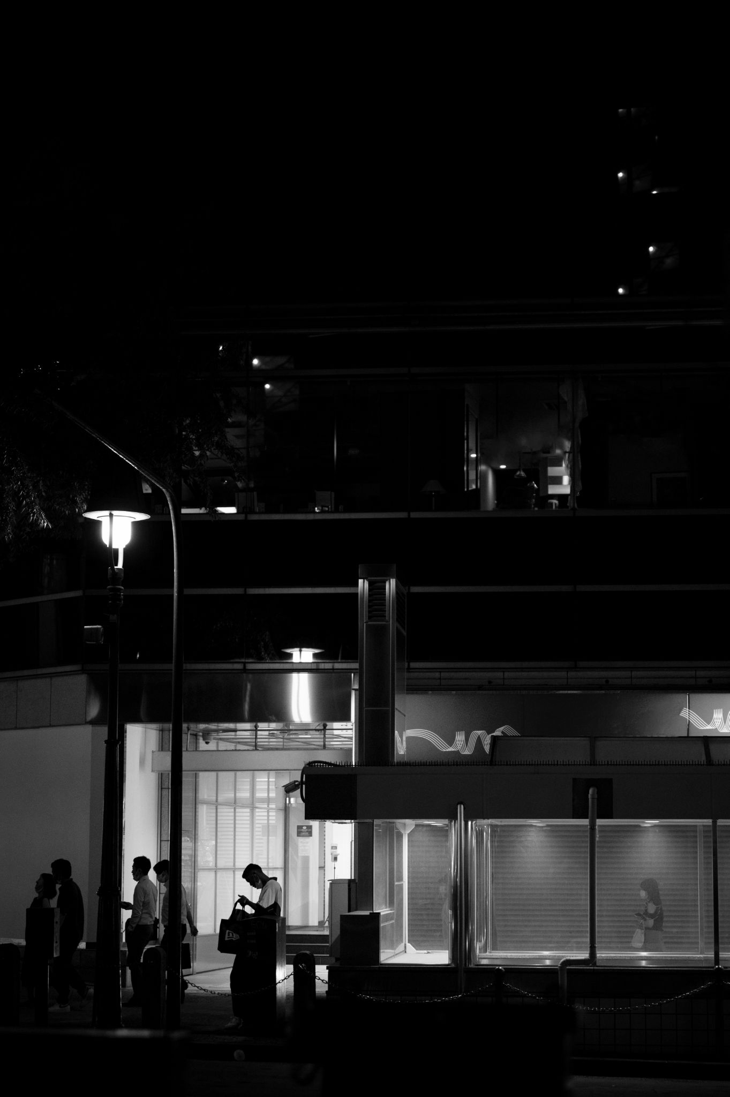

ONLINE MOVIE TICKET RESERVATION SYSTEM
PROJECT ABSTRACT
Our project basically manages the ticket booking process of a multiplex, providing an interface to the user to book movie tickets in an easier way. The project proceeds through a sequence of well-designed forms provided with validations to ensure consistency, reliability and most importantly correctness of information fed into the database.

Slide 4

PROJECT INTRODUCTION
ONLINE MOVIE TICKET RESERVATION SYSTEM
Internet based online movie ticket reservation system for cinema halls which can be accessed over internet. This web application will automate the reservation of tickets and enquiries about availability of the seats. This application includes email confirmation for the tickets. Users can subscribe to new release mailers.

Slide 5

SCOPE OF THE PROJECT
ONLINE MOVIE TICKET RESERVATION SYSTEM
Our project basically manages the ticket booking process of a multiplex, providing an interface to the user to book movie tickets in an easier way. The project proceeds through a sequence of well-designed forms provided with validations to ensure consistency, reliability and most importantly correctness of information fed into the database

Slide 6
HARDWARE REQUIREMENTS:
ONLINE MOVIE TICKET RESERVATION SYSTEM
Processor | Intel Core i5
RAM | 8GB RAM
Hard Disk | 160 GB or More
Input Device | Standard Keyboard and Mouse
Output Device | 15’’ LED Monitor

Slide 7
SOFTWARE REQUIREMENTS:
ONLINE MOVIE TICKET RESERVATION SYSTEM
Front End | ASP.NET 2010
Back End | SQL Server
Operation System | Windows 10

Slide 8
PROJECT MODULES
01
SIGN UP
ONLINE MOVIE TICKET RESERVATION SYSTEM
05
UPCOMING MOVIE
02
ADMIN LOGIN
06
CURRENTLY MOVIES
03
CUSTOMER LOGIN
07
PER-RELEASE
04
CUSTOMER APPROVAL
08
REVIEWS
09
DISPLAY BOOKING MOVIE

Slide 9
DATA FLOW DIAGRAMS
ONLINE MOVIE TICKET RESERVATION SYSTEM
DFD1:-
CUSTOMER
ON SCREEN MOVIES
LOGIN
CUSTOMER HOME
UPCOMING MOVIES
Booking Ticket
RE-RELEASE MOVIES
Booking Ticket PAYMENT

Slide 10
DATA FLOW DIAGRAMS
ONLINE MOVIE TICKET RESERVATION SYSTEM
DFD2:-
APPROVED LIST
ADMIN
SIGN UP
REQUEST LIST
CUSTOMER DISPLAY
REJECTED LIST
LOGIN
ADMIN HOME
UPCOMING MOVIES
BOOKING LIST
BOOKING DISPLAY
RECOMMENED MOVIES

Slide 11
DATA FLOW DIAGRAMS
ONLINE MOVIE TICKET RESERVATION SYSTEM
DFD3:-
ADMIN
LOGIN
ADMIN HOME PAGE
DFD4:-
CUSTOMER
LOGIN
CUSTOMER HOME PAGE

Slide 12
DATA FLOW DIAGRAMS
ONLINE MOVIE TICKET RESERVATION SYSTEM
DFD5:-
ON SCREEN MOVIES
UPCOMING MOVIES
CUSTOMER HOME
PAGE
RE-RELEASE MOVIES
Booking Ticket

Slide 13
ER DIRAGRAM
ONLINE MOVIE TICKET RESERVATION SYSTEM
Last Name
Movie Name
Time
Purl
Pname
First Name
Movie ID
Seat Number
Booing ID
Status
Comfirm Password
Email
Number
Date
Books Seats
DOB
Booking
Signup
Gender
Screen Name
Password
Married
Aadhar
Age
Customer Number
Has
Total Amt
Manages
Manages
Rating ID
Movie ID
Movie Rating
Manages
Admin
Cust ID
Movie Name
Rating
Username
Password

Slide 14
DATABASE SCHEMA
ONLINE MOVIE TICKET RESERVATION SYSTEM
ADMIN TAB:-
Column name | Data Type | Constraints
Username | Varchar(50) | Primary key
Password | Varchar(50) | Not null

Slide 15
ONLINE MOVIE TICKET RESERVATION SYSTEM
SIGN UP:-
Column name | Data Type | Constraints
Firstname | varchar(50) | Primary key
lastname | varchar(50) | Not null
email | varchar(50) | Not null
number | numeric(18, 0) | Not null
DOB | varchar(50) | Not null
age | varchar(50) | Not null
Aadhar | varchar(50) | Not null
Gender | varchar(50) | Not null
Married | varchar(50) | Not null
Password | varchar(50) | Not null
Comfirmpassword | varchar(50) | Not null
Pname | varchar(50) | Not null
Purl | varchar(50) | Not null
Status | varchar(50) | Not null

Slide 16
ONLINE MOVIE TICKET RESERVATION SYSTEM
BOOKING TAB:-
Column name | Data Type | Constraints
BookingID | numeric(18, 0) | Primary key
MovieID | numeric(18, 0) | Not null
CustomerNumber | numeric(18, 0) | Not null
MovieName | varchar(50) | Not null
Date | varchar(50) | Not null
Screennumber | varchar(50) | Not null
Time | varchar(50) | Not null
SeatNumber | varchar(50) | Not null
TotalAmt | numeric(18, 0) | Not null

Slide 17
ONLINE MOVIE TICKET RESERVATION SYSTEM
RATING TAB:-
Column name | Data Type | Constraints
RatingID | numeric(18, 0) | Primary key
CustID | numeric(18, 0) | Not null
MovieID | numeric(18, 0) | Not null
MoveName | varchar(50) | Not null
Rating | numeric(18, 0) | Not null
RatingID | numeric(18, 0) | Not null
CustID | numeric(18, 0) | Not null
MovieID | numeric(18, 0) | Not null
MoveName | varchar(50) | Not null

Slide 18

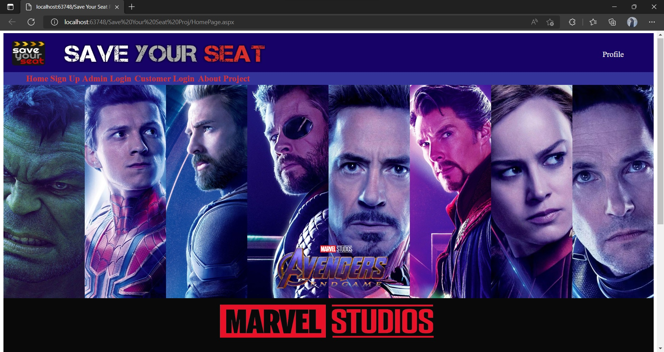
INPUT/OUTPUT SCREEN
ONLINE MOVIE TICKET RESERVATION SYSTEM
HOME PAGE

Slide 19
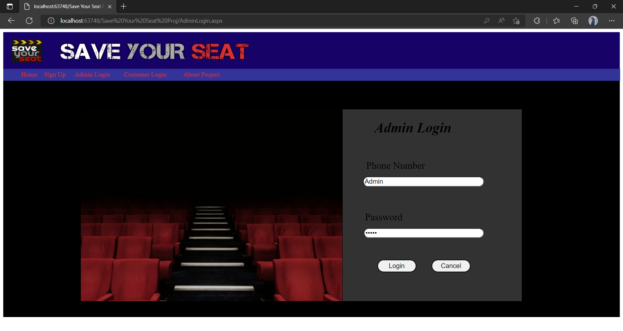
ONLINE MOVIE TICKET RESERVATION SYSTEM
ADMIN LOGIN

Slide 20
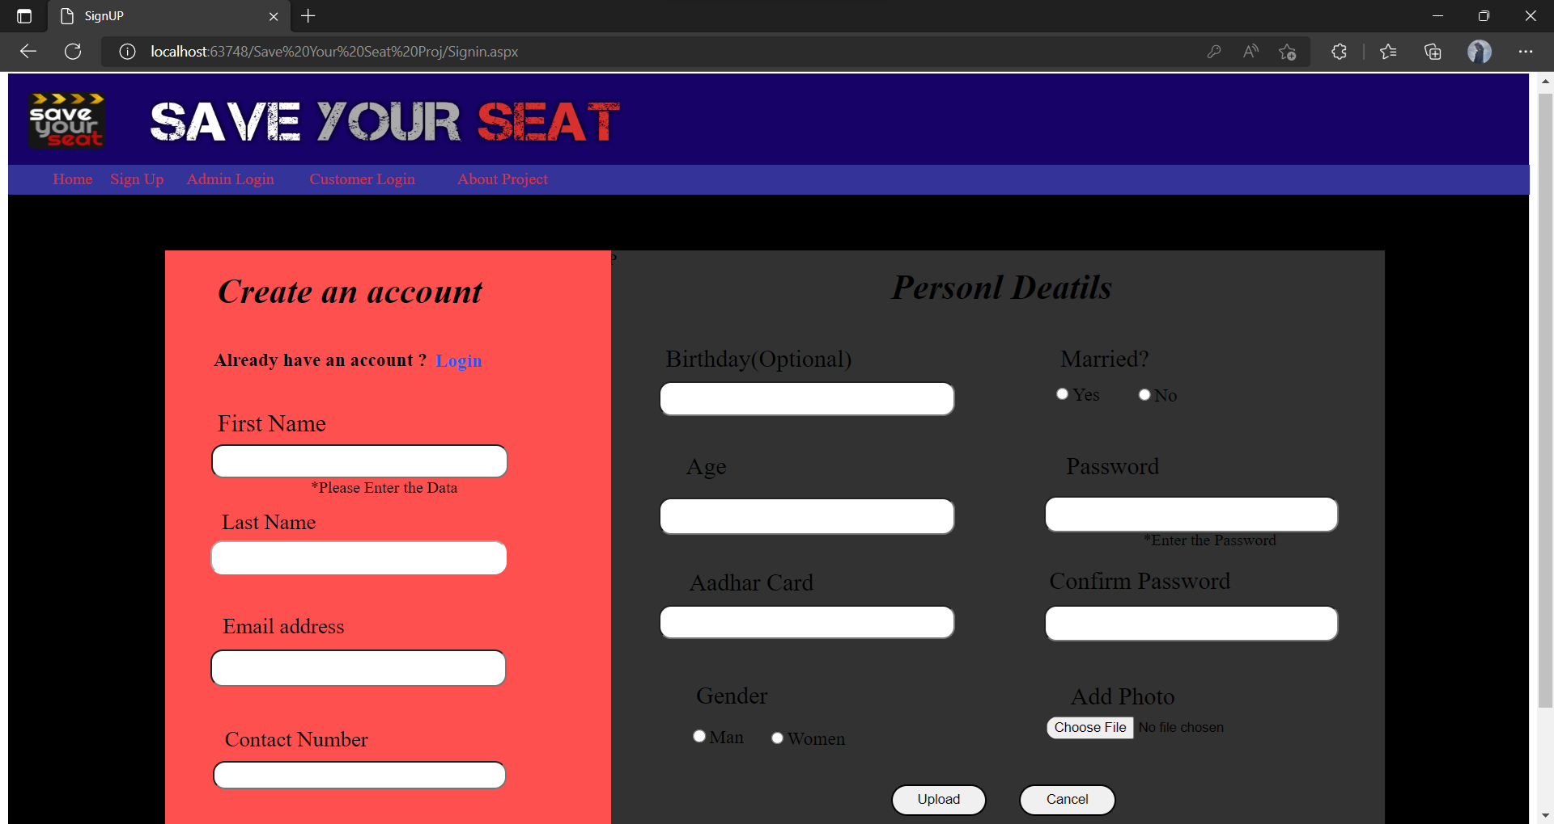
ONLINE MOVIE TICKET RESERVATION SYSTEM
SIGN UP

Slide 21
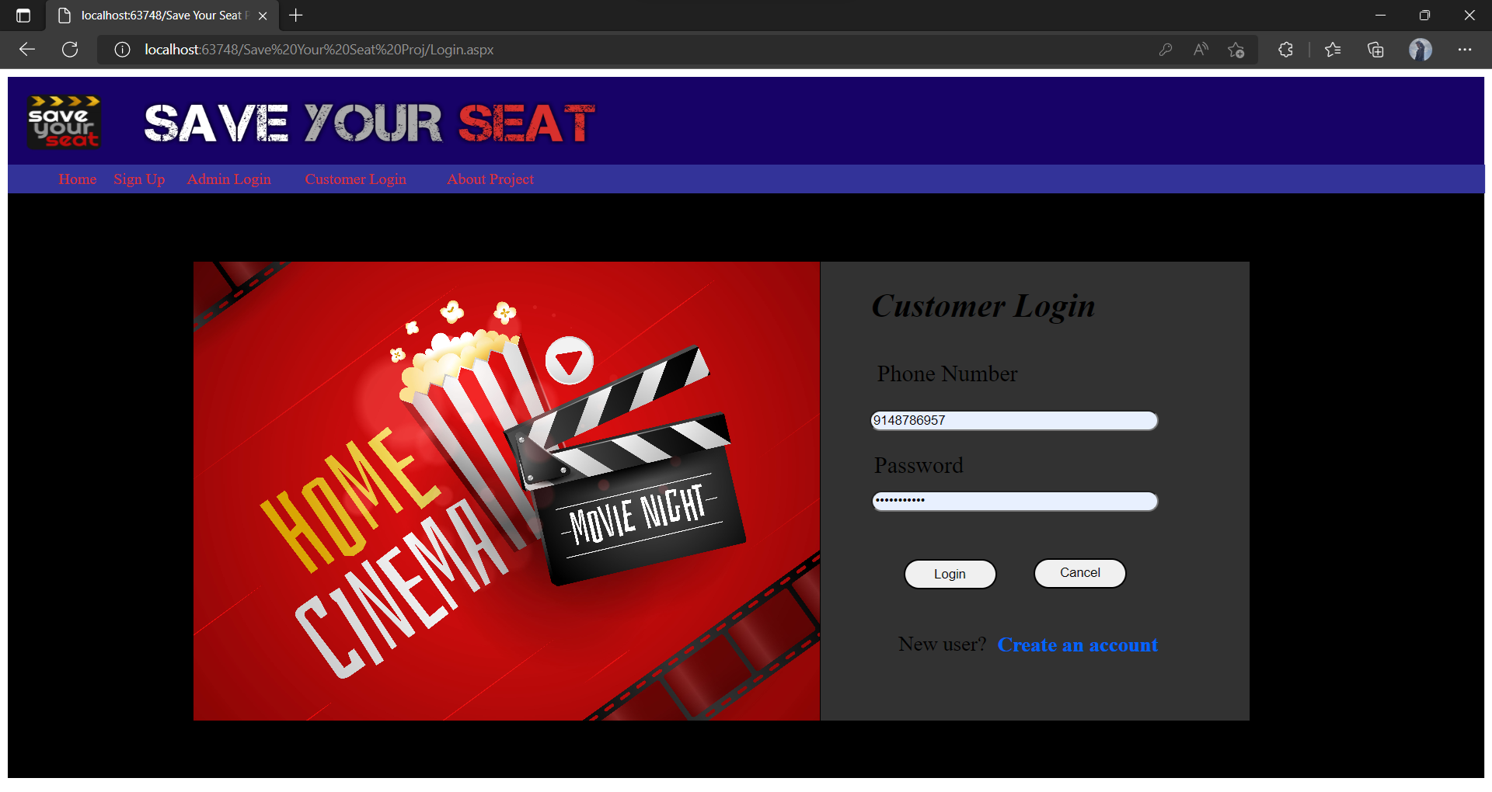
ONLINE MOVIE TICKET RESERVATION SYSTEM
CUSTOMER LOGIN

Slide 22
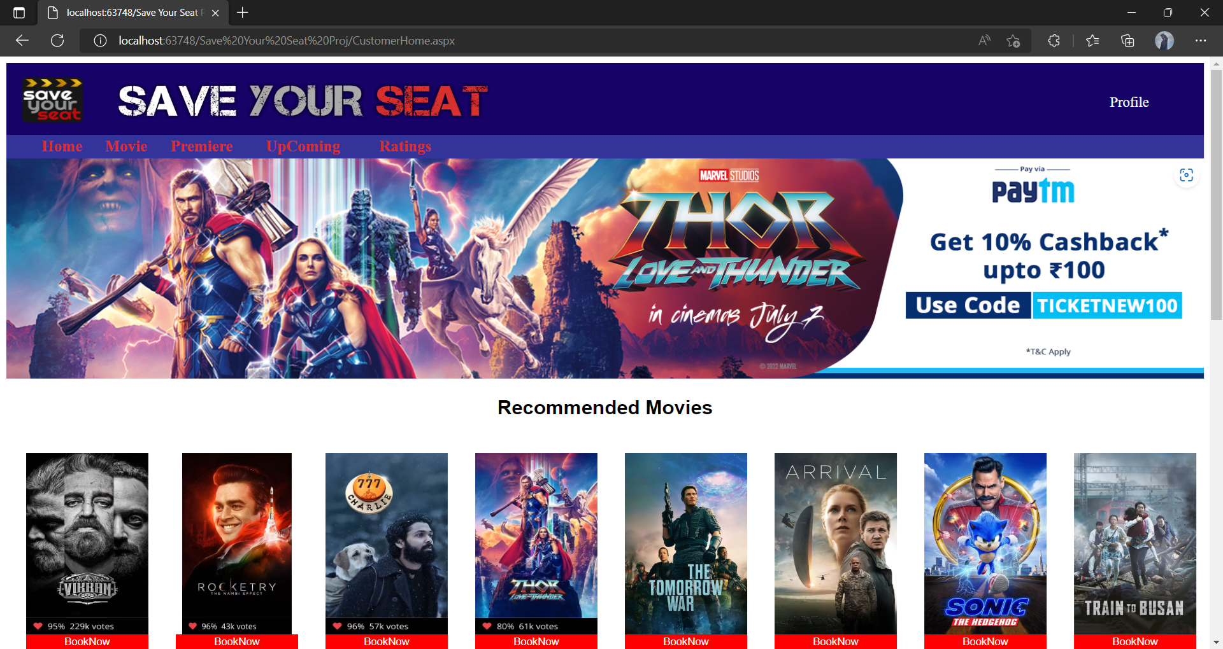
ONLINE MOVIE TICKET RESERVATION SYSTEM
CUSTOMER HOME PAGE

Slide 23
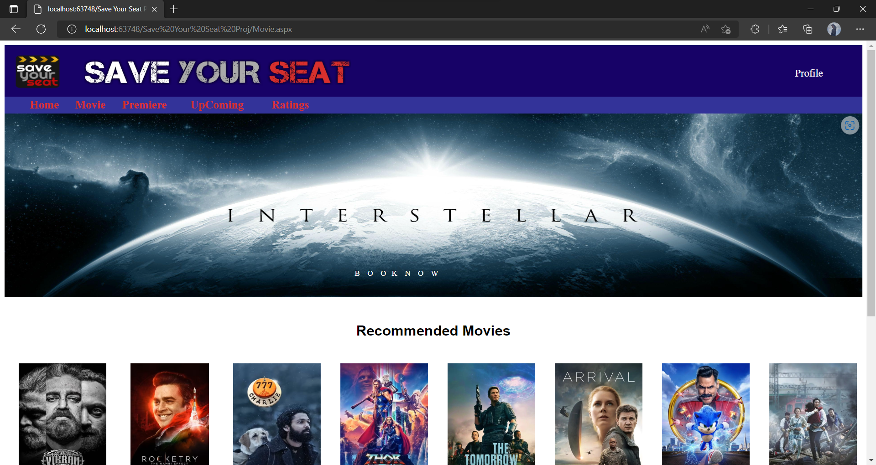
ONLINE MOVIE TICKET RESERVATION SYSTEM
CURRENTLY MOVIES

Slide 24
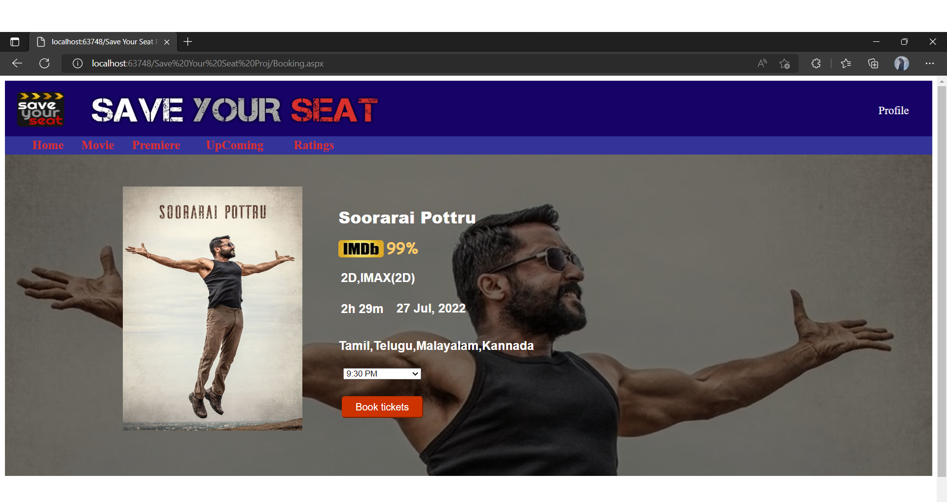
ONLINE MOVIE TICKET RESERVATION SYSTEM
CUSTOMER BOOKING

Slide 25
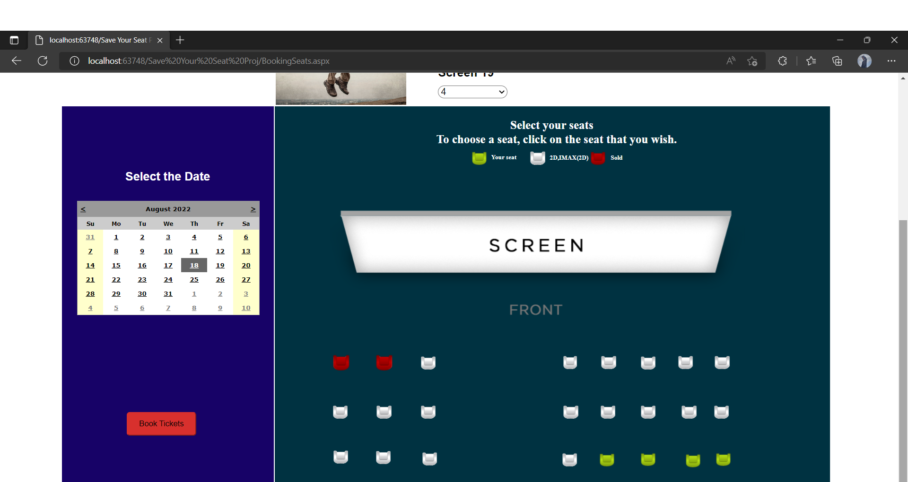
ONLINE MOVIE TICKET RESERVATION SYSTEM
CUSTOMER BOOKING SEAT

Slide 26
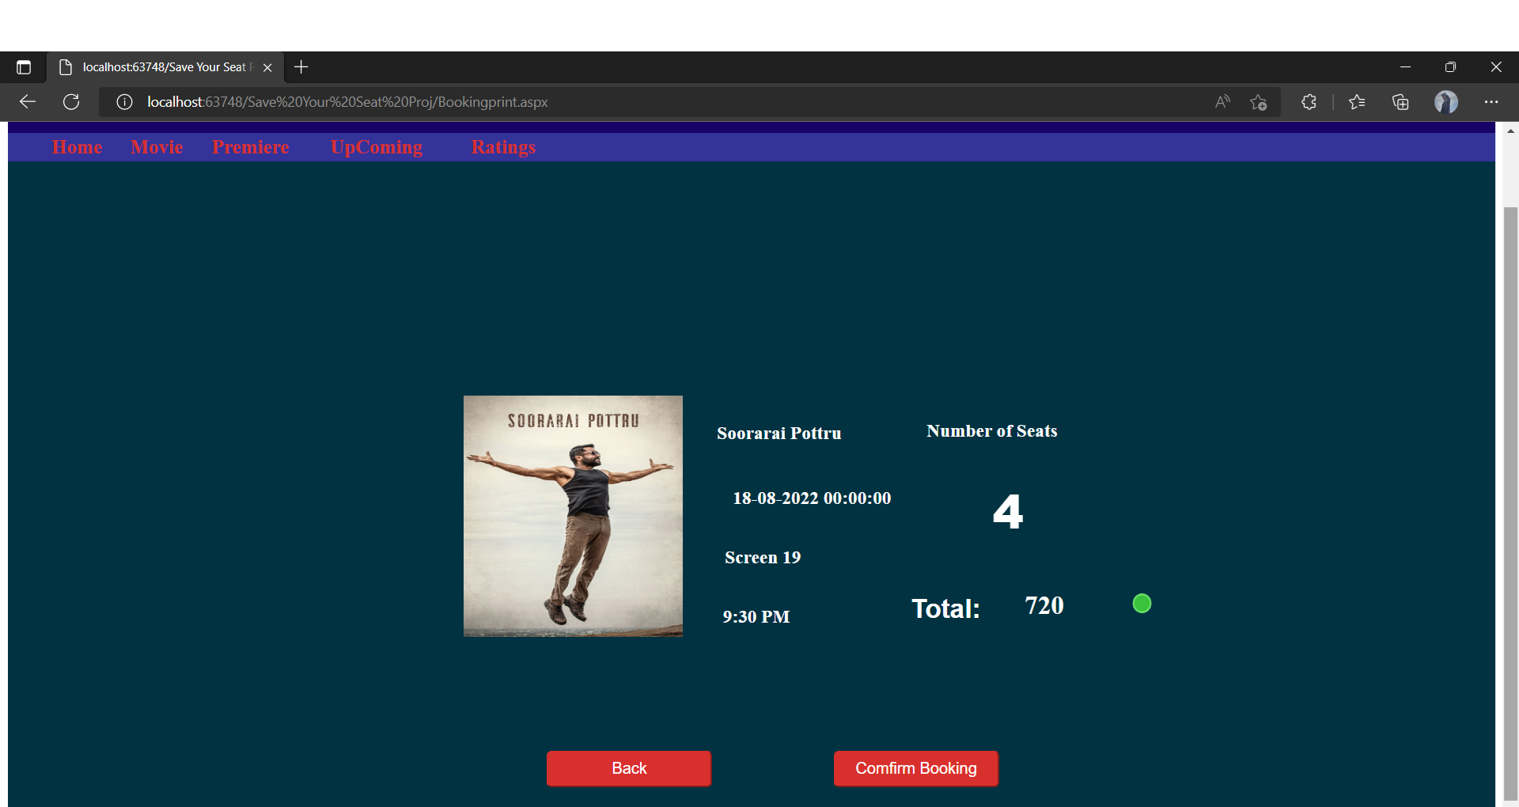
ONLINE MOVIE TICKET RESERVATION SYSTEM
PAYMENT BOOKING

Slide 27
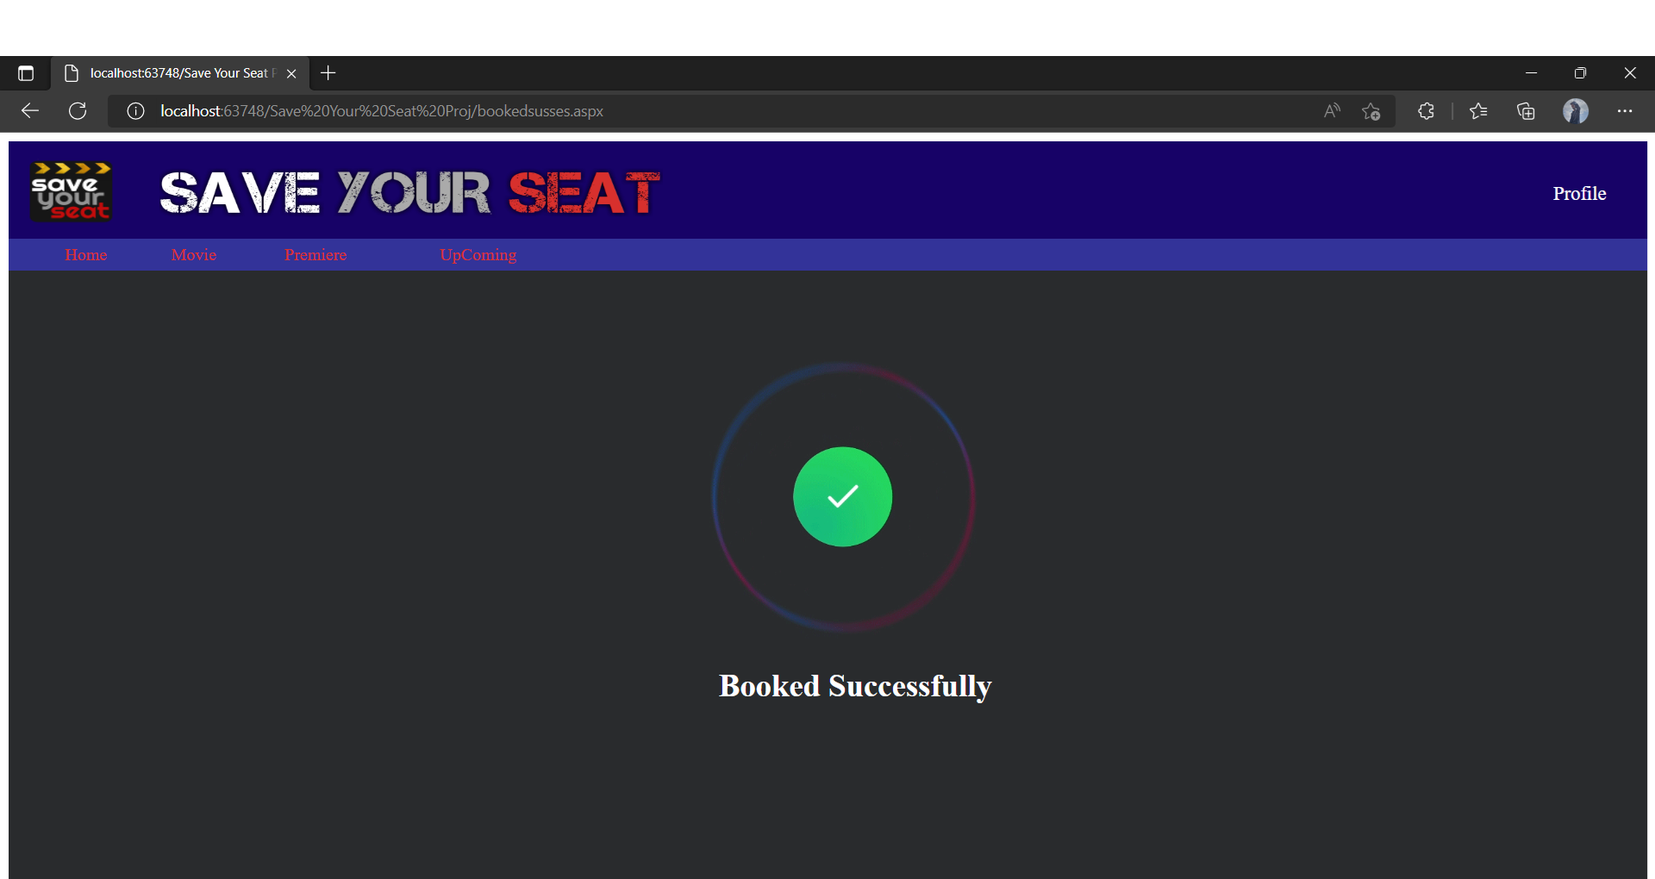
ONLINE MOVIE TICKET RESERVATION SYSTEM
BOOKING SUCCESSFULLY

Slide 28
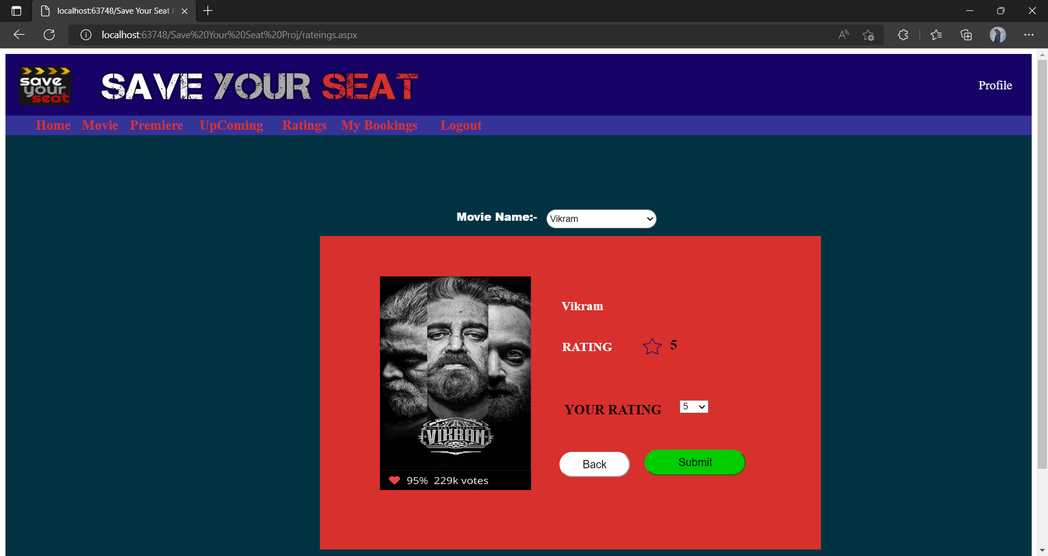
ONLINE MOVIE TICKET RESERVATION SYSTEM
MOVIE RATINGS

Slide 29
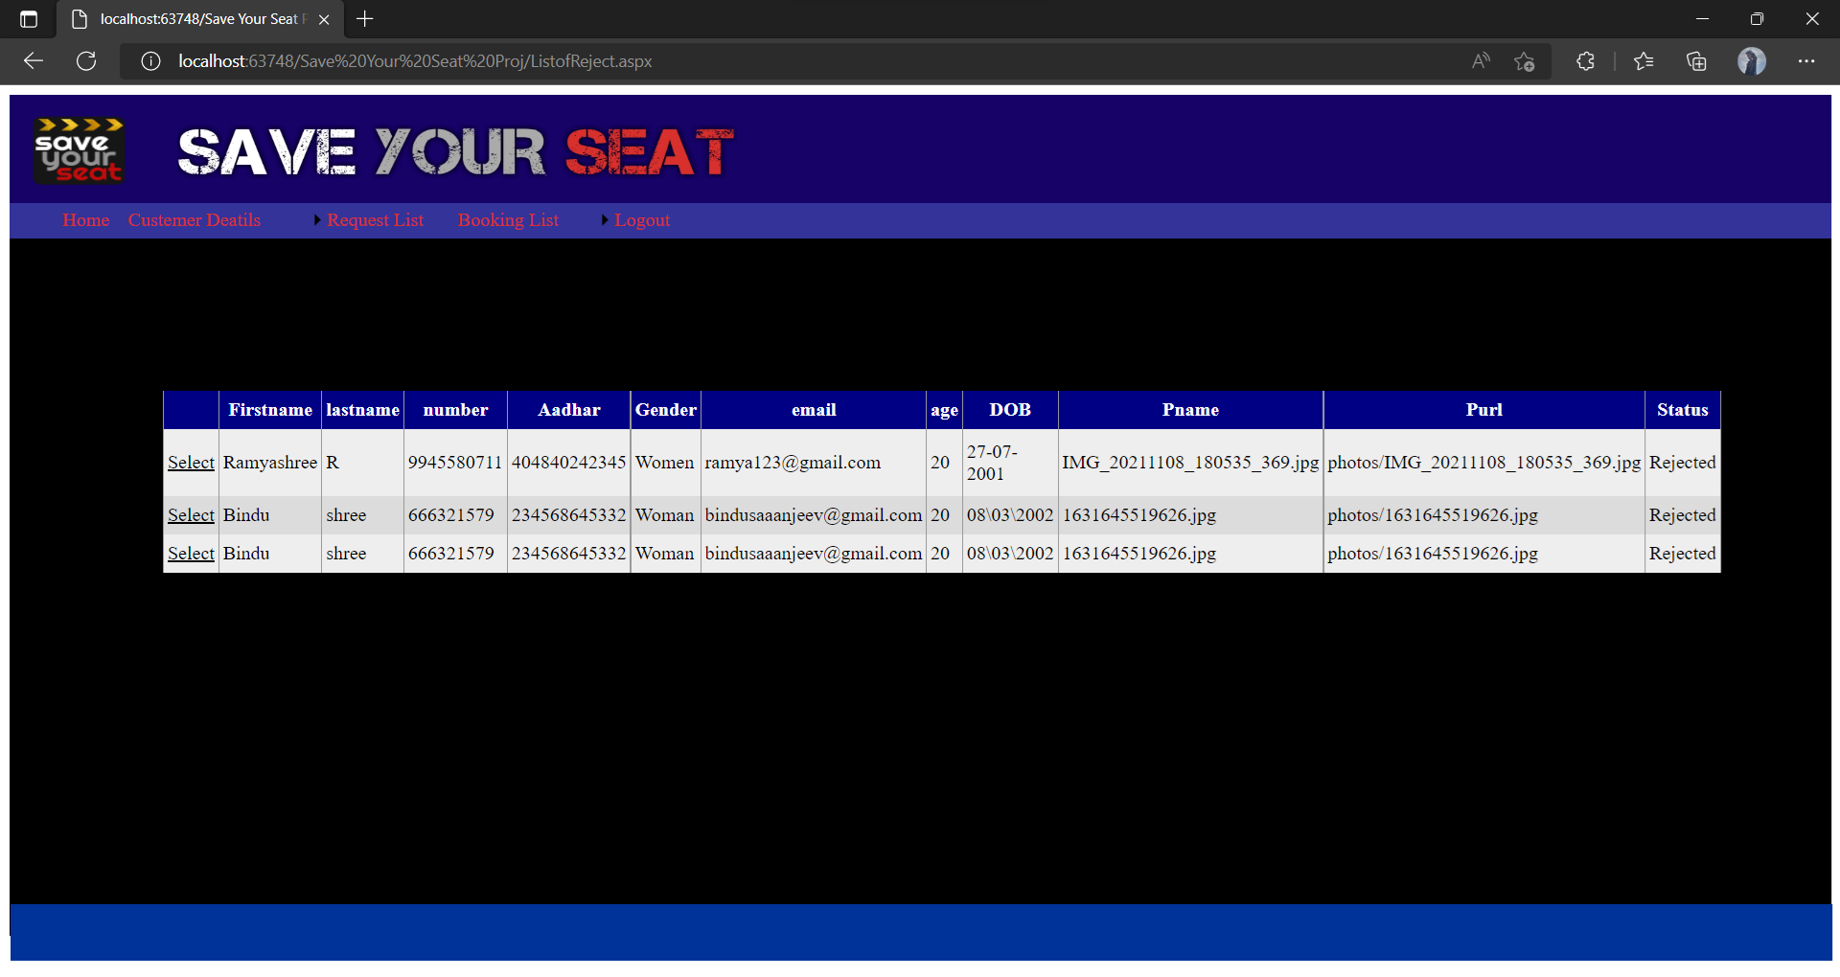
ONLINE MOVIE TICKET RESERVATION SYSTEM
REJECTED LISTS

Slide 30
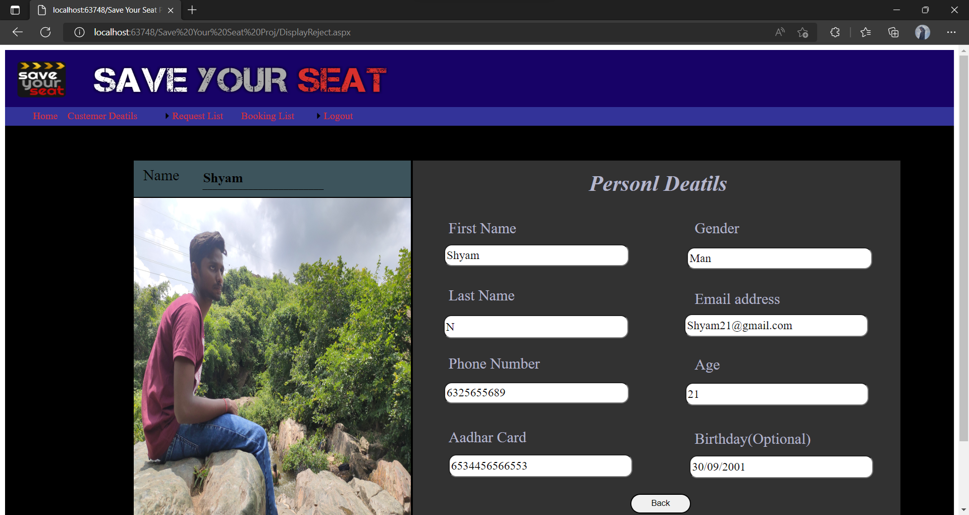
ONLINE MOVIE TICKET RESERVATION SYSTEM
REJECTED PROFILE DETAILS

Slide 31
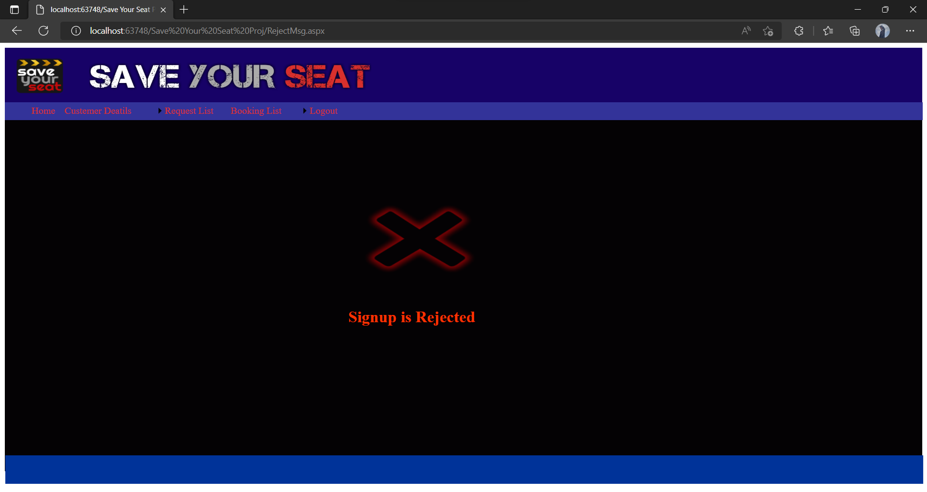
ONLINE MOVIE TICKET RESERVATION SYSTEM
SIGNUP REJECTED

Slide 32
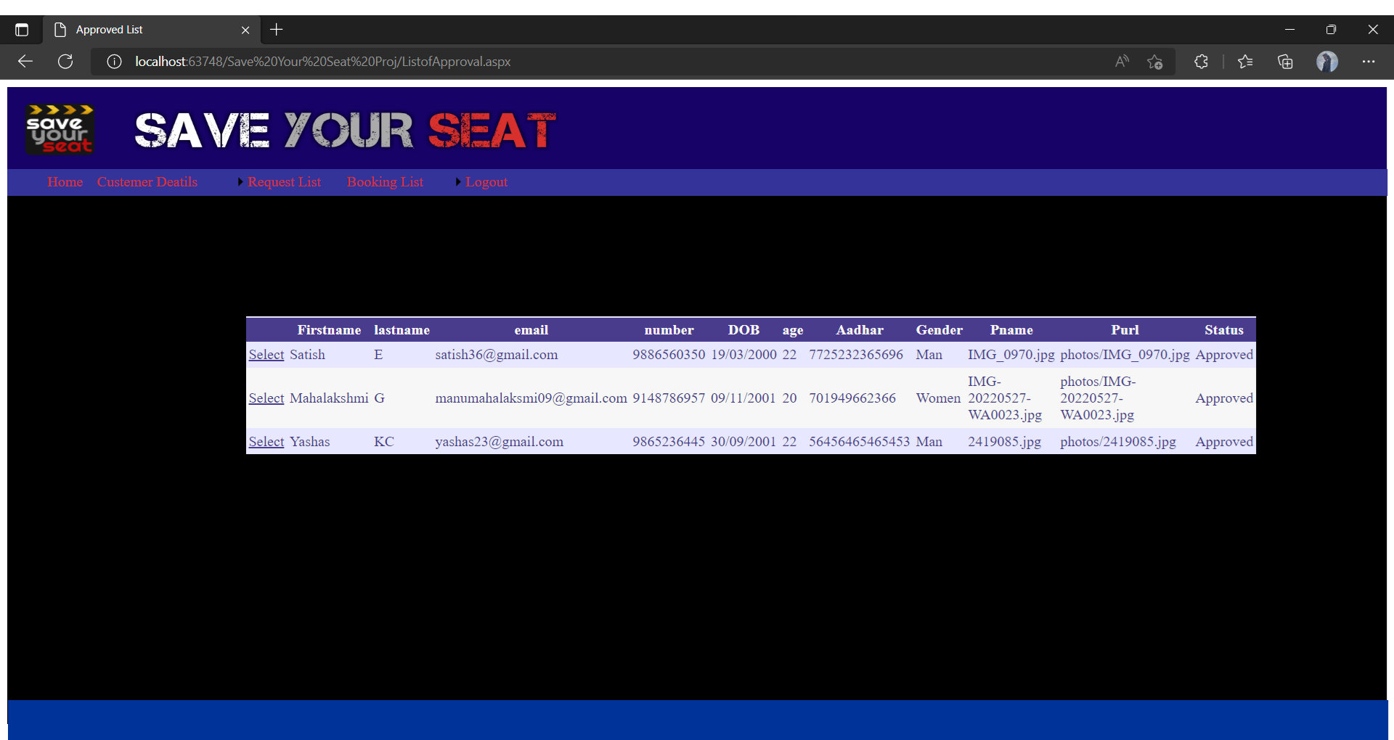
ONLINE MOVIE TICKET RESERVATION SYSTEM
APPROVED LISTS

Slide 33
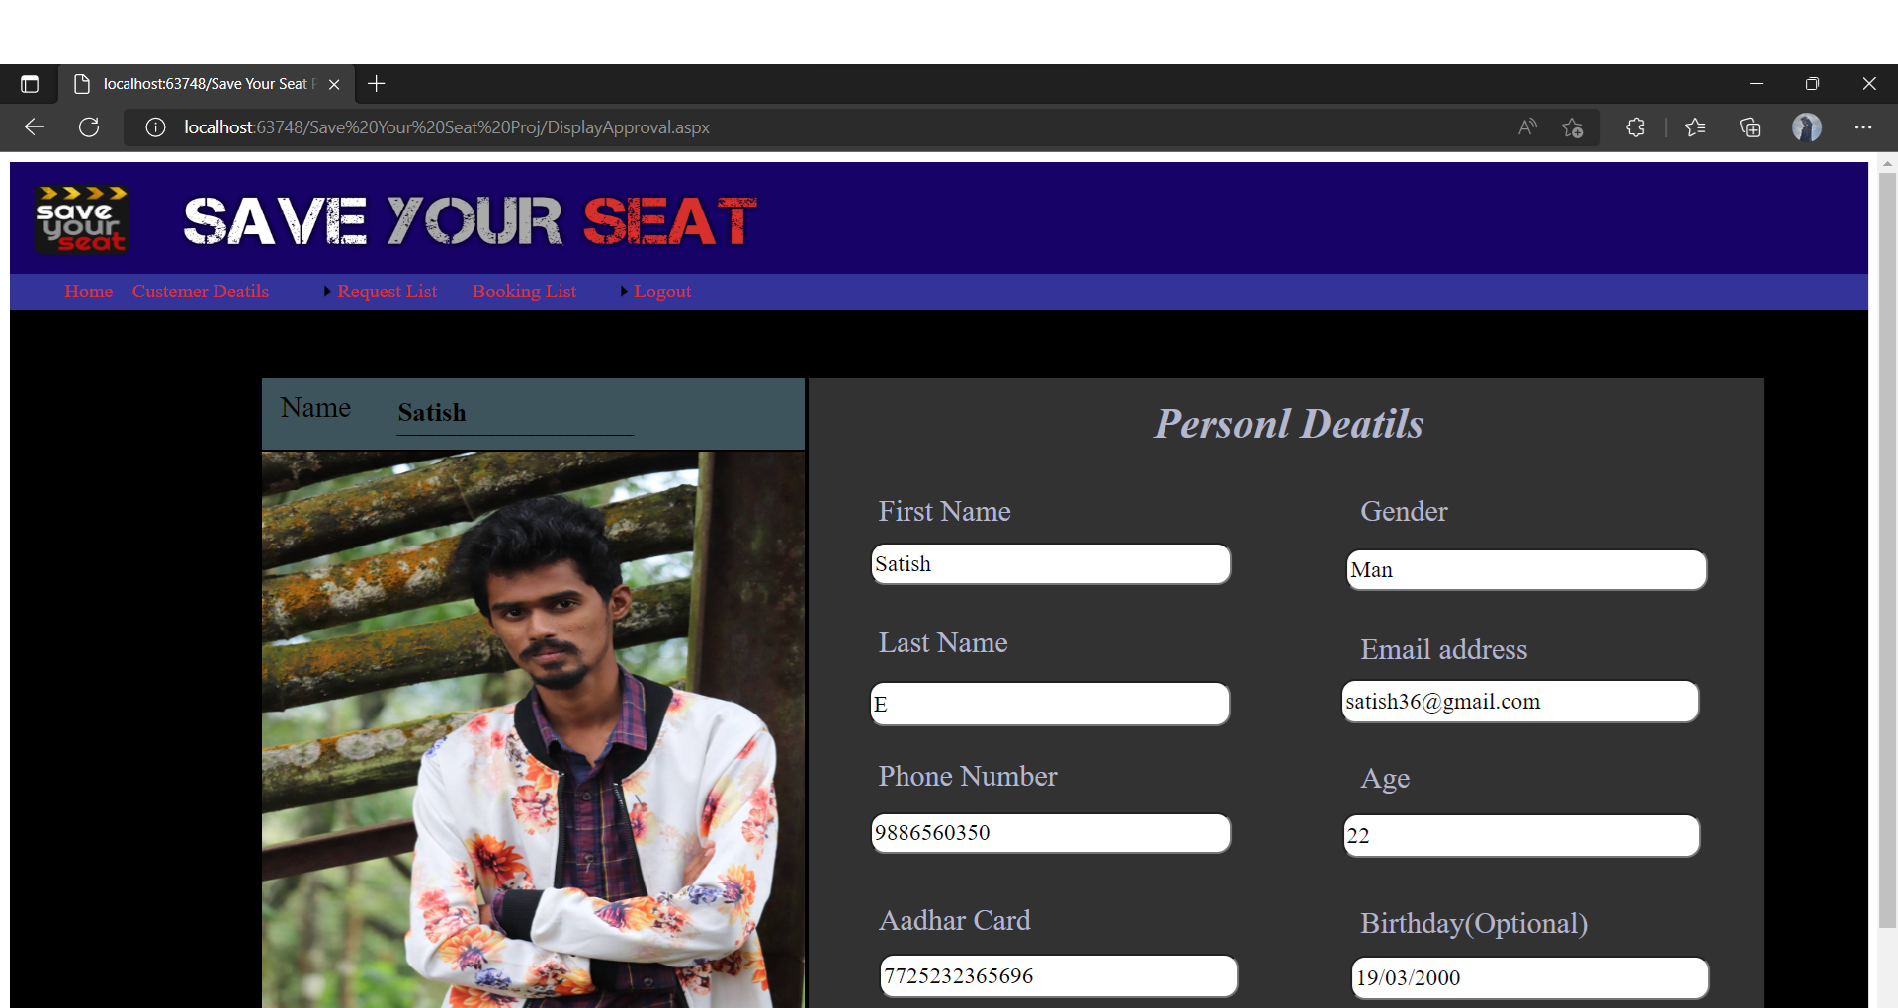
ONLINE MOVIE TICKET RESERVATION SYSTEM
APPROVED DETAILS

Slide 34
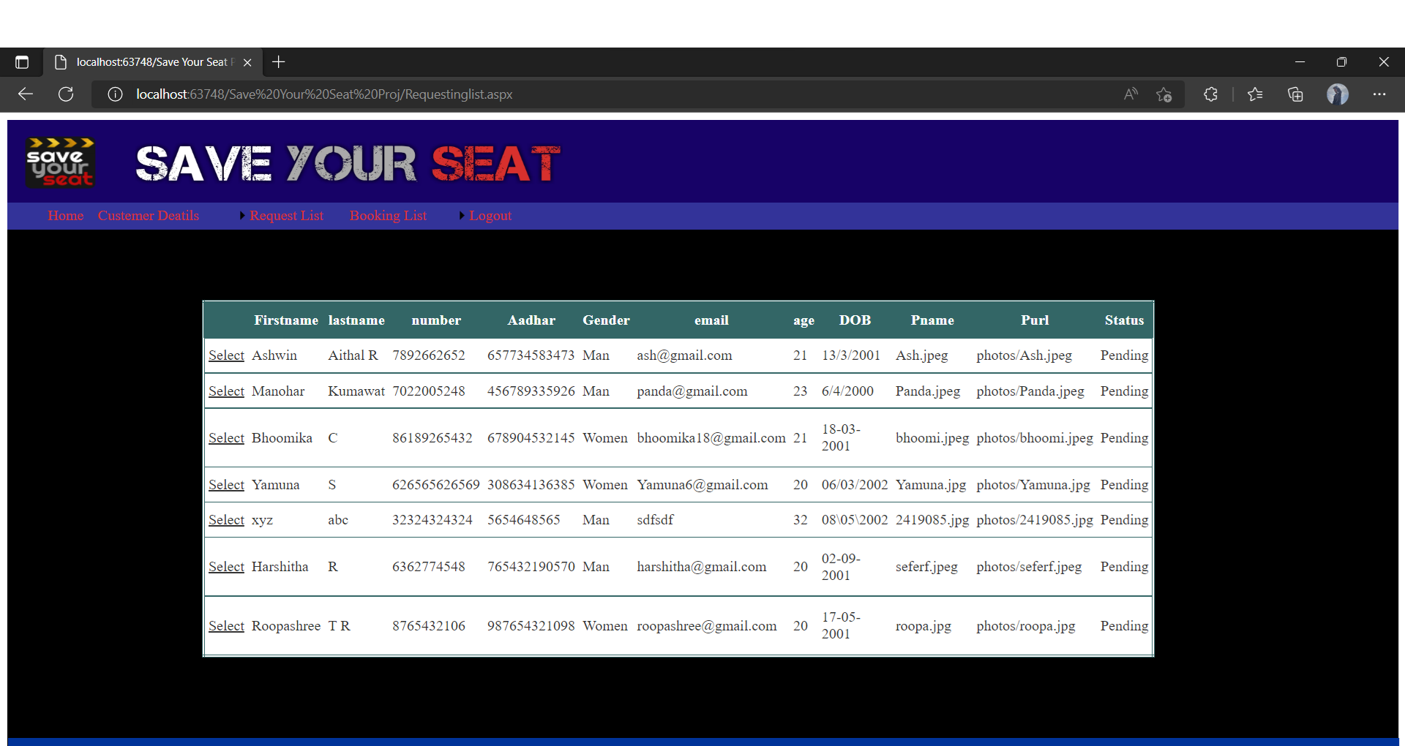
ONLINE MOVIE TICKET RESERVATION SYSTEM
REQUEST LIST

Slide 35
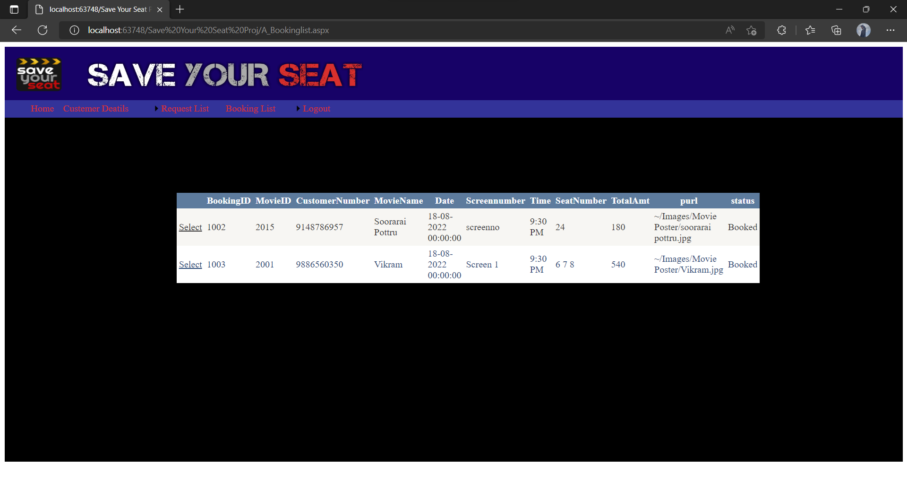
ONLINE MOVIE TICKET RESERVATION SYSTEM
MOVIE BOOKING LIST

Slide 36
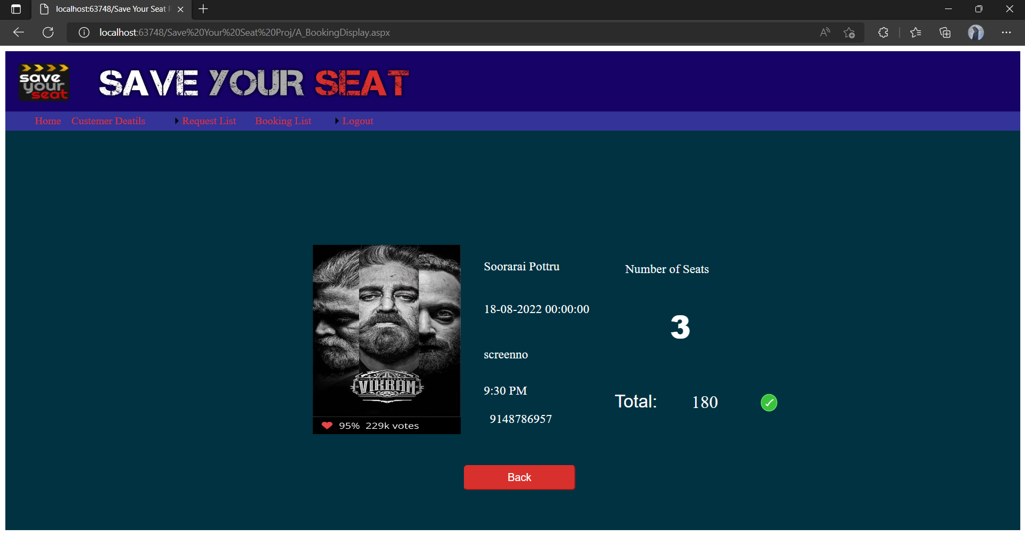
ONLINE MOVIE TICKET RESERVATION SYSTEM
MOVIE BOOKING DISPLAY

Slide 37
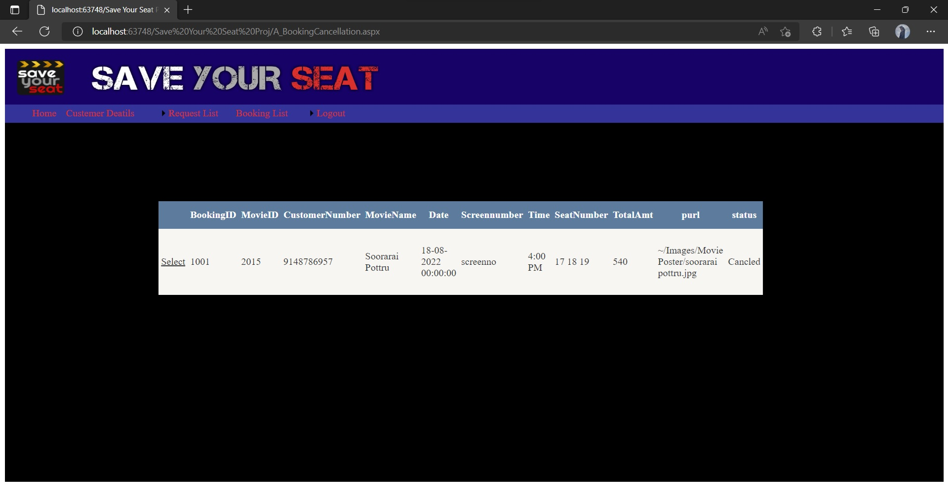
ONLINE MOVIE TICKET RESERVATION SYSTEM
MOVIE BOOKING CANCELLED

Slide 38
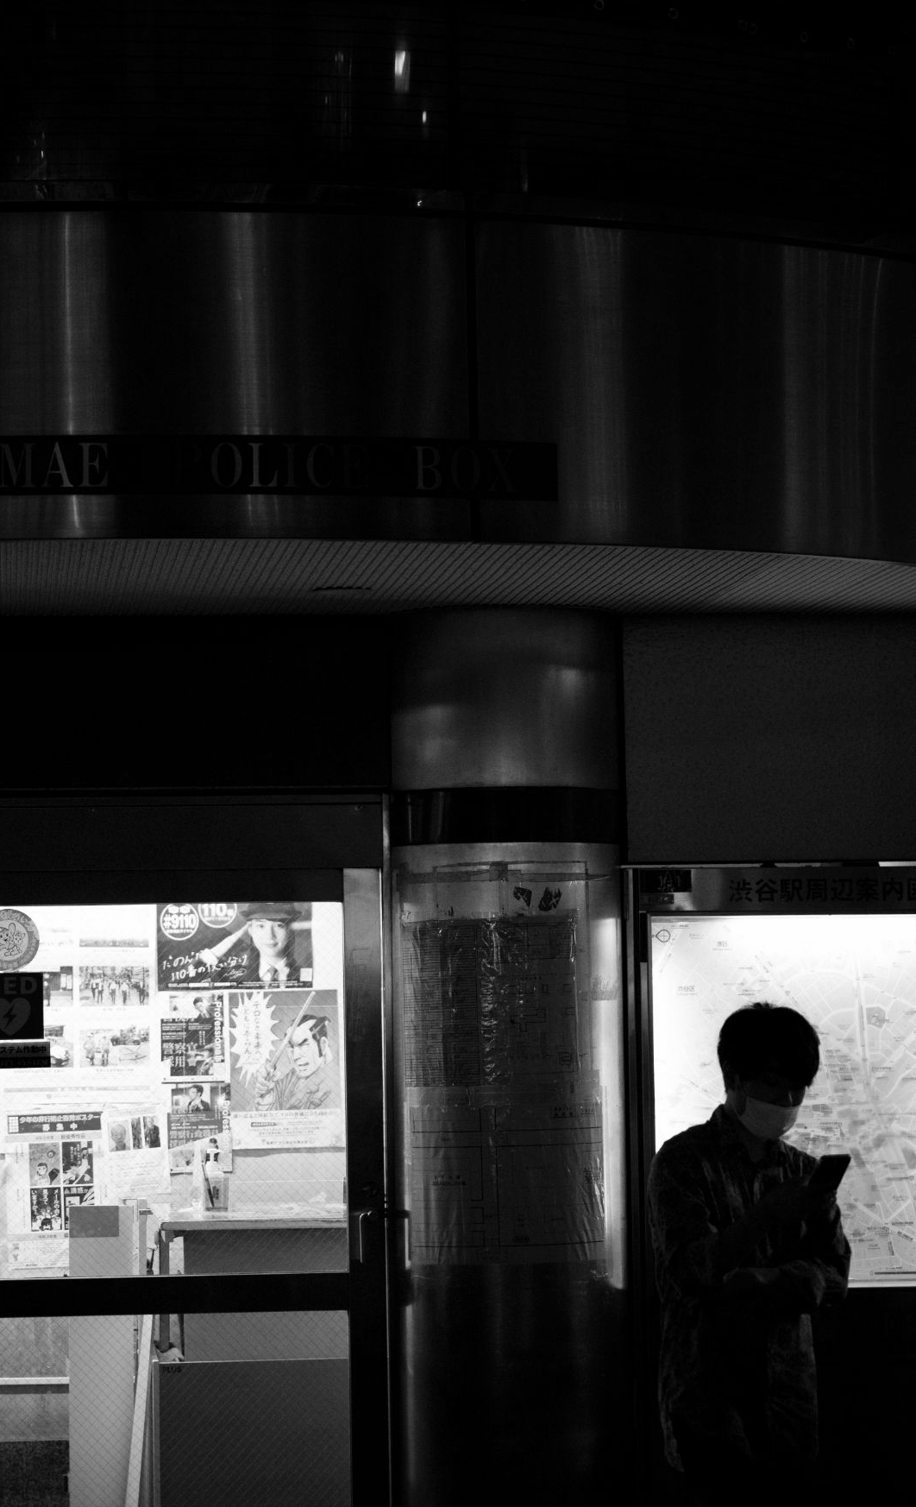
CONCLUSIONS
ONLINE MOVIE TICKET RESERVATION SYSTEM
The system is designed in such an extendable fashion to incorporate the future changes into the system easily. Any particular can be added easily and get connected to the menu. The various user-friendly features are introduced in this project. There are several future ideas to develop this application, still in mind. All the links to other forms are generated and are tested with the actual system.
The database connectivity is tested with the user requirements and verified for the validity. The software requirements have been met. Needed documents are generated and adequate documentation has been provided for maintenance and further enhancements. The operation required by the user to operate the system is basic computer knowledge only.
Finally, this is Well graphics project and all the forms are very easy to understand for every computer operator, so that the transactions of the databases for completely recorded in a report in the form of SQL data report. No confusions for the required Final printing reports for all modules in well apped project such as Booking, Reviews, Upcoming Movies, Pre-Release Movies, Movies, Payment. These modules are completely validated and 100% verifications done in the frontend tool visual studio and inserted well graphics design.

Slide 39
FUTURE ENHANCEMENTS
ONLINE MOVIE TICKET RESERVATION SYSTEM
Enhancement means adding, modifying or redeveloping the code to support changes in the specifications. It is necessary to keep up with changing user needs and the operational environment.
Since no system is ever complete, Online Movie Ticket Reservation System can further be developed to include more operations and analysis, as changes are required by end users of the system. In future we are going to implement sports and events in this project.
The System can also be developed using ASP.NET with the help of Application software.
The system can also be developed for all Online Movie Ticket Reservation System.
Graphical Reports can be designed with graphs such as data flow diagram and ER diagram. This will provide clear picture of a ratio of the data can be stored data can be retained for future enhancement.

Slide 40

ONLINE MOVIE TICKET RESERVATION SYSTEM
THANKS!
Do you have any questions?
Satishelumalai123@gmail.com
+91 9886560350
Thenameissatish19

